Slide 1


1
Healthcare
Dialysis of Patients
Data Analysis
Team Members
2
SAYALI
PRERNA
SHIVANI
SAURABH
TANMAYA TEJA

Slide 2
1
Healthcare
Dialysis of Patients
Data Analysis
Team Members
2
SAYALI
PRERNA
SHIVANI
SAURABH
TANMAYA TEJA
Introduction
Welcome to the Dialysis of Patients project in the healthcare domain.
This project focuses on analyzing and improving the dialysis process for better patient outcomes.
We have utilized two datasets, namely Dialysis – I & Dialysis – II, in CSV format, each containing over 7,000 records.
3
Objective
The main objectives of this project are to analyze key performance indicators (KPIs) related to dialysis.
Gain insights into patient outcomes, organizational performance, and financial aspects to inform data-driven decision-making.

Slide 3
Team Members
2
SAYALI
PRERNA
SHIVANI
SAURABH
TANMAYA TEJA
Introduction
Welcome to the Dialysis of Patients project in the healthcare domain.
This project focuses on analyzing and improving the dialysis process for better patient outcomes.
We have utilized two datasets, namely Dialysis – I & Dialysis – II, in CSV format, each containing over 7,000 records.
3
Objective
The main objectives of this project are to analyze key performance indicators (KPIs) related to dialysis.
Gain insights into patient outcomes, organizational performance, and financial aspects to inform data-driven decision-making.
Data Sources
Dialysis1 sheet
Dialysis2 sheet
4

Slide 4

Introduction
Welcome to the Dialysis of Patients project in the healthcare domain.
This project focuses on analyzing and improving the dialysis process for better patient outcomes.
We have utilized two datasets, namely Dialysis – I & Dialysis – II, in CSV format, each containing over 7,000 records.
3
Objective
The main objectives of this project are to analyze key performance indicators (KPIs) related to dialysis.
Gain insights into patient outcomes, organizational performance, and financial aspects to inform data-driven decision-making.
Data Sources
Dialysis1 sheet
Dialysis2 sheet
4
Number of Patients across Summaries
Insight
The Survival summary with the highest count (1,937,701) underscores the critical importance of understanding factors influencing patient survival rates.
KPI-1
5
Next Step
Analyze successful survival cases, share best practices, and consider implementing standardized care plans.
Conclusion
Optimizing survival strategies, with a focus on disseminating successful practices, is crucial for overall improvement in patient outcomes.

Slide 5
Data Sources
Dialysis1 sheet
Dialysis2 sheet
4
Number of Patients across Summaries
Insight
The Survival summary with the highest count (1,937,701) underscores the critical importance of understanding factors influencing patient survival rates.
KPI-1
5
Next Step
Analyze successful survival cases, share best practices, and consider implementing standardized care plans.
Conclusion
Optimizing survival strategies, with a focus on disseminating successful practices, is crucial for overall improvement in patient outcomes.
Profit Vs Non-Profit Stats
Insight
The significant difference in counts between non-profit (869) and profit (6,854) chain organizations suggests a varied landscape with dominant for-profit entities.
7723
Total
KPI-2
5
Next Step
Encourage collaboration between profit and non-profit organizations for knowledge exchange.
Conclusion
The notable disparity in organizational counts between profit and non-profit entities necessitates in-depth analysis for informed strategic decision-making.

Slide 6
Number of Patients across Summaries
Insight
The Survival summary with the highest count (1,937,701) underscores the critical importance of understanding factors influencing patient survival rates.
KPI-1
5
Next Step
Analyze successful survival cases, share best practices, and consider implementing standardized care plans.
Conclusion
Optimizing survival strategies, with a focus on disseminating successful practices, is crucial for overall improvement in patient outcomes.
Profit Vs Non-Profit Stats
Insight
The significant difference in counts between non-profit (869) and profit (6,854) chain organizations suggests a varied landscape with dominant for-profit entities.
7723
Total
KPI-2
5
Next Step
Encourage collaboration between profit and non-profit organizations for knowledge exchange.
Conclusion
The notable disparity in organizational counts between profit and non-profit entities necessitates in-depth analysis for informed strategic decision-making.
NO SCORE Chain Organizations
American Renal Associates
6
Chain Org. w.r.t Total Perf. as No Score
17
Atlantis Healthcare Group
Centers for Dialysis Care
2
Davita
119
Insight
The presence of 352 organizations with no assigned performance score raises concerns about the comprehensiveness of performance tracking.
Dialysis Clinic, INC.
8
Dislyspa
3
Dialysze Direct PA LLC
1
352
Total
KPI-3
Diamond Dialysis, LLC
1
5
Freedom Dialysis, LLC
1
Next Step
Implement regular reviews and updates to the performance scoring system for increased accuracy.
Fresenius Medical Care
118
I Dialysis, LLC
1
Independent
53
1
Innovative Dialysis Systems
Nephrology Care Partners
1
Conclusion
Resolving issues related to organizations without assigned performance scores is vital for comprehensive performance tracking and improvement.
Northwest Kidney Centers
1
Sankar Nephrology Group
1
Sula Dialysis
1
UPMC Health System
1
US Renal Care, INC.
16

Slide 7
Profit Vs Non-Profit Stats
Insight
The significant difference in counts between non-profit (869) and profit (6,854) chain organizations suggests a varied landscape with dominant for-profit entities.
7723
Total
KPI-2
5
Next Step
Encourage collaboration between profit and non-profit organizations for knowledge exchange.
Conclusion
The notable disparity in organizational counts between profit and non-profit entities necessitates in-depth analysis for informed strategic decision-making.
NO SCORE Chain Organizations
American Renal Associates
6
Chain Org. w.r.t Total Perf. as No Score
17
Atlantis Healthcare Group
Centers for Dialysis Care
2
Davita
119
Insight
The presence of 352 organizations with no assigned performance score raises concerns about the comprehensiveness of performance tracking.
Dialysis Clinic, INC.
8
Dislyspa
3
Dialysze Direct PA LLC
1
352
Total
KPI-3
Diamond Dialysis, LLC
1
5
Freedom Dialysis, LLC
1
Next Step
Implement regular reviews and updates to the performance scoring system for increased accuracy.
Fresenius Medical Care
118
I Dialysis, LLC
1
Independent
53
1
Innovative Dialysis Systems
Nephrology Care Partners
1
Conclusion
Resolving issues related to organizations without assigned performance scores is vital for comprehensive performance tracking and improvement.
Northwest Kidney Centers
1
Sankar Nephrology Group
1
Sula Dialysis
1
UPMC Health System
1
US Renal Care, INC.
16
Davita
50102
Dialysis Stations Stats
Fresenius Medical Care
49135
Insight
DAVITA leading with 50,102 stations and FRESENIUS MEDICAL CARE with 49,135 stations suggests a concentration of dialysis services in these major providers.
Independent
11739
DCI
4822
KPI-4
5
ARA
4608
Next Step
Implement strategies to improve operational efficiency for organizations with a lower number of stations.
Total Dialysis Stations
135055
Conclusion
Collaborative knowledge-sharing is crucial for efficient dialysis station management, especially for organizations with a high number of stations.

Slide 8
NO SCORE Chain Organizations
American Renal Associates
6
Chain Org. w.r.t Total Perf. as No Score
17
Atlantis Healthcare Group
Centers for Dialysis Care
2
Davita
119
Insight
The presence of 352 organizations with no assigned performance score raises concerns about the comprehensiveness of performance tracking.
Dialysis Clinic, INC.
8
Dislyspa
3
Dialysze Direct PA LLC
1
352
Total
KPI-3
Diamond Dialysis, LLC
1
5
Freedom Dialysis, LLC
1
Next Step
Implement regular reviews and updates to the performance scoring system for increased accuracy.
Fresenius Medical Care
118
I Dialysis, LLC
1
Independent
53
1
Innovative Dialysis Systems
Nephrology Care Partners
1
Conclusion
Resolving issues related to organizations without assigned performance scores is vital for comprehensive performance tracking and improvement.
Northwest Kidney Centers
1
Sankar Nephrology Group
1
Sula Dialysis
1
UPMC Health System
1
US Renal Care, INC.
16
Davita
50102
Dialysis Stations Stats
Fresenius Medical Care
49135
Insight
DAVITA leading with 50,102 stations and FRESENIUS MEDICAL CARE with 49,135 stations suggests a concentration of dialysis services in these major providers.
Independent
11739
DCI
4822
KPI-4
5
ARA
4608
Next Step
Implement strategies to improve operational efficiency for organizations with a lower number of stations.
Total Dialysis Stations
135055
Conclusion
Collaborative knowledge-sharing is crucial for efficient dialysis station management, especially for organizations with a high number of stations.
#6714
Hospital Readmission Category
#6659
PPPW Category
Count of Category text – As Expected
Insight
High counts of 'As Expected' outcomes in categories like SWR (6,818) and PPPW (6,714) indicate positive performance in these areas.
#6818
Hospitalization Category
#6517
Fistula Category
KPI-5
5
Category Text Count (As Expected)
Next Step
Share best practices across organizations to maintain positive outcomes in these and other categories.
#3623
SWR Category
#6108
Transfusion Category
Conclusion
Positive outcomes in SWR and PPPW categories highlight success areas.
#5011
Infection Category
#5966
Survival Category

Slide 9
Davita
50102
Dialysis Stations Stats
Fresenius Medical Care
49135
Insight
DAVITA leading with 50,102 stations and FRESENIUS MEDICAL CARE with 49,135 stations suggests a concentration of dialysis services in these major providers.
Independent
11739
DCI
4822
KPI-4
5
ARA
4608
Next Step
Implement strategies to improve operational efficiency for organizations with a lower number of stations.
Total Dialysis Stations
135055
Conclusion
Collaborative knowledge-sharing is crucial for efficient dialysis station management, especially for organizations with a high number of stations.
#6714
Hospital Readmission Category
#6659
PPPW Category
Count of Category text – As Expected
Insight
High counts of 'As Expected' outcomes in categories like SWR (6,818) and PPPW (6,714) indicate positive performance in these areas.
#6818
Hospitalization Category
#6517
Fistula Category
KPI-5
5
Category Text Count (As Expected)
Next Step
Share best practices across organizations to maintain positive outcomes in these and other categories.
#3623
SWR Category
#6108
Transfusion Category
Conclusion
Positive outcomes in SWR and PPPW categories highlight success areas.
#5011
Infection Category
#5966
Survival Category
Average Payment Reduction Rate
0.81%
Insight
The average payment reduction rate of 0.81% reflects a modest reduction in payments, which is generally manageable.
KPI-6
5
Next Step
Regularly assess and adjust financial strategies to align with changes in payment policies and reimbursement structures.
Conclusion
Prioritizing balanced strategies for financial sustainability while maintaining high-quality care is crucial.

Slide 10

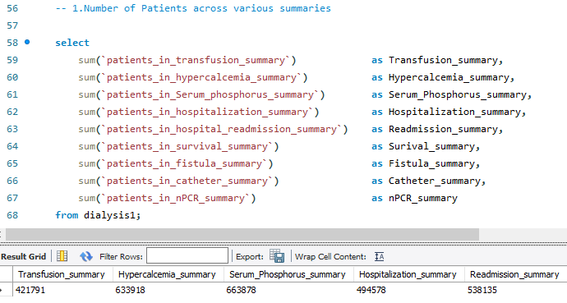
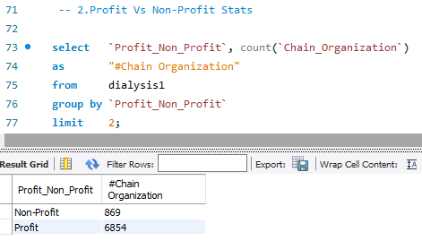
#6714
Hospital Readmission Category
#6659
PPPW Category
Count of Category text – As Expected
Insight
High counts of 'As Expected' outcomes in categories like SWR (6,818) and PPPW (6,714) indicate positive performance in these areas.
#6818
Hospitalization Category
#6517
Fistula Category
KPI-5
5
Category Text Count (As Expected)
Next Step
Share best practices across organizations to maintain positive outcomes in these and other categories.
#3623
SWR Category
#6108
Transfusion Category
Conclusion
Positive outcomes in SWR and PPPW categories highlight success areas.
#5011
Infection Category
#5966
Survival Category
Average Payment Reduction Rate
0.81%
Insight
The average payment reduction rate of 0.81% reflects a modest reduction in payments, which is generally manageable.
KPI-6
5
Next Step
Regularly assess and adjust financial strategies to align with changes in payment policies and reimbursement structures.
Conclusion
Prioritizing balanced strategies for financial sustainability while maintaining high-quality care is crucial.
Query 1
MySQL Queries
6
Query 2

Slide 11
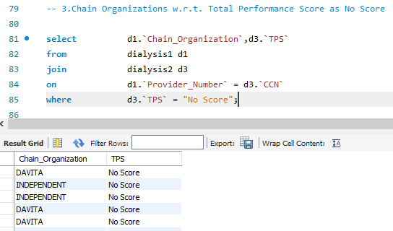
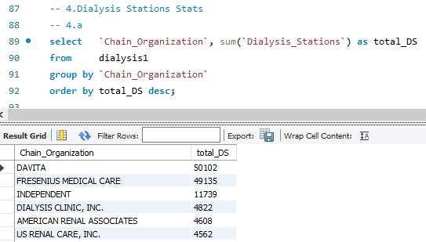
Average Payment Reduction Rate
0.81%
Insight
The average payment reduction rate of 0.81% reflects a modest reduction in payments, which is generally manageable.
KPI-6
5
Next Step
Regularly assess and adjust financial strategies to align with changes in payment policies and reimbursement structures.
Conclusion
Prioritizing balanced strategies for financial sustainability while maintaining high-quality care is crucial.
Query 1
MySQL Queries
6
Query 2
Query 3
MySQL Queries
6
Query 4

Slide 12
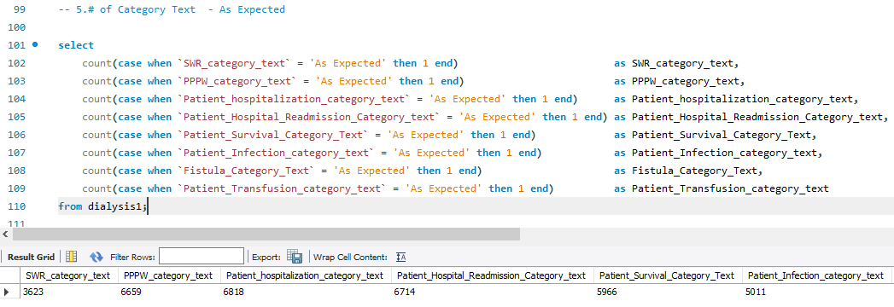
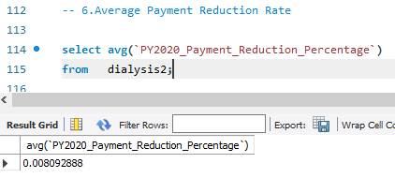
Query 1
MySQL Queries
6
Query 2
Query 3
MySQL Queries
6
Query 4
Query 5
MySQL Queries
6
Query 6

Slide 13


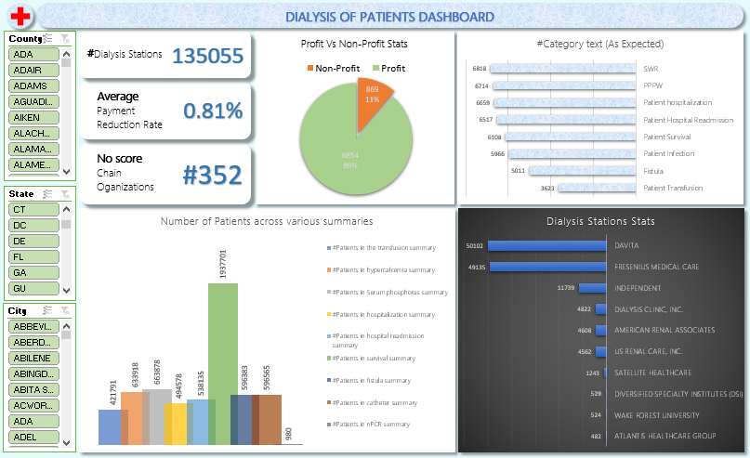
Query 3
MySQL Queries
6
Query 4
Query 5
MySQL Queries
6
Query 6
Dashboard
7

Slide 14

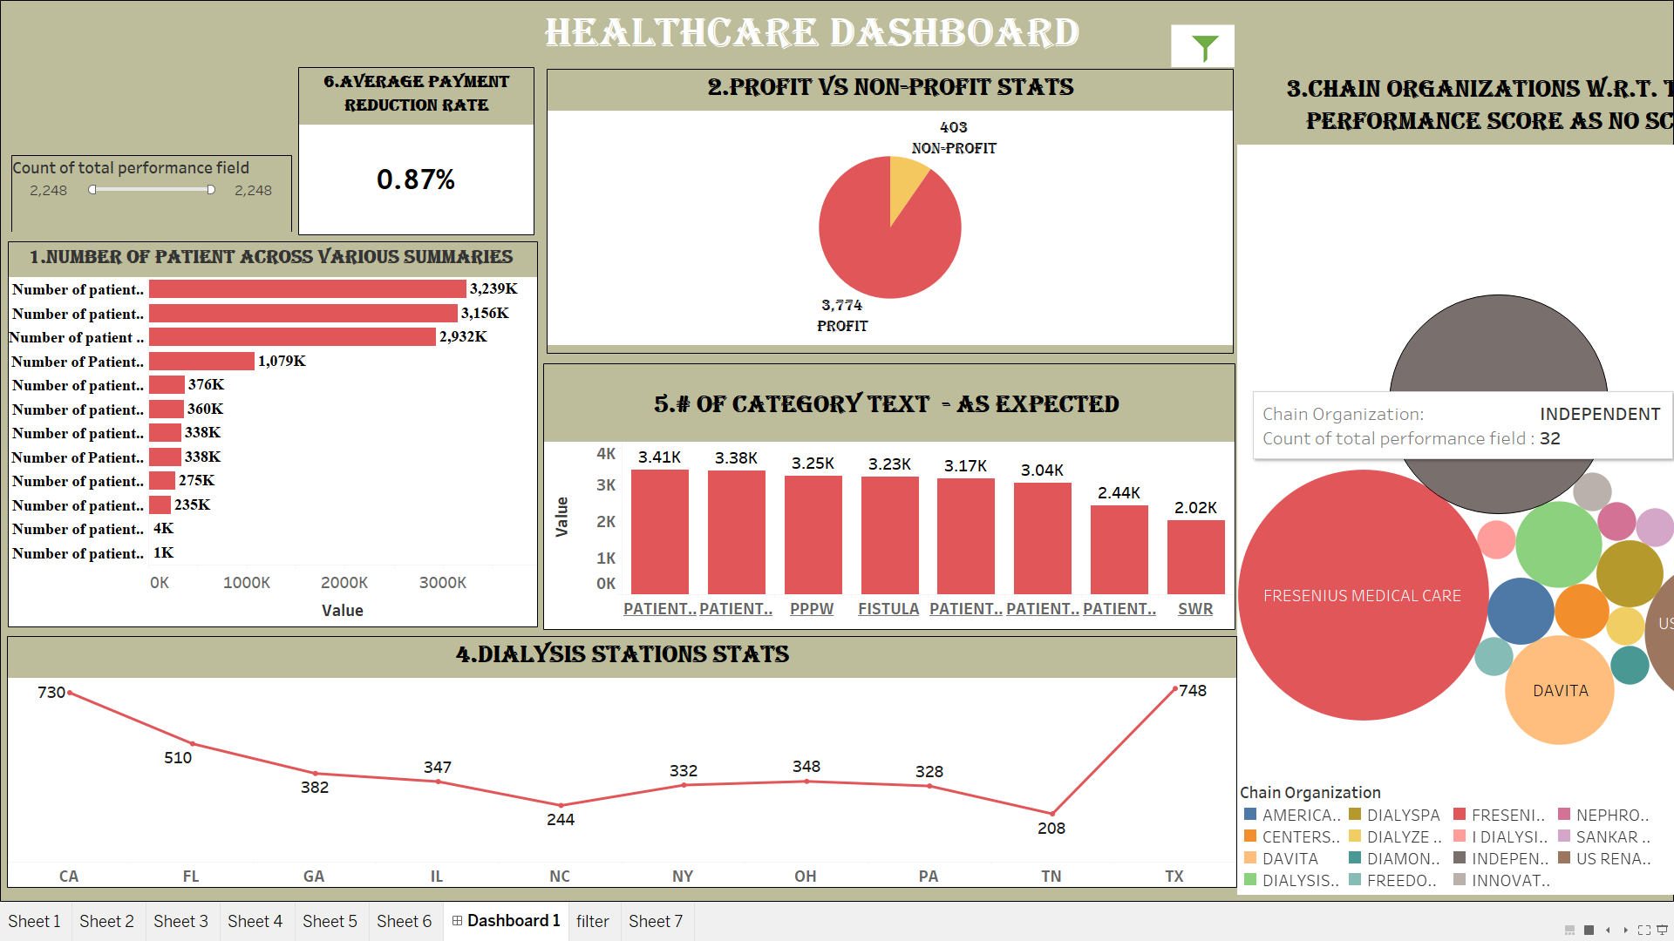
Query 5
MySQL Queries
6
Query 6
Dashboard
7
Dashboard
7

Slide 15

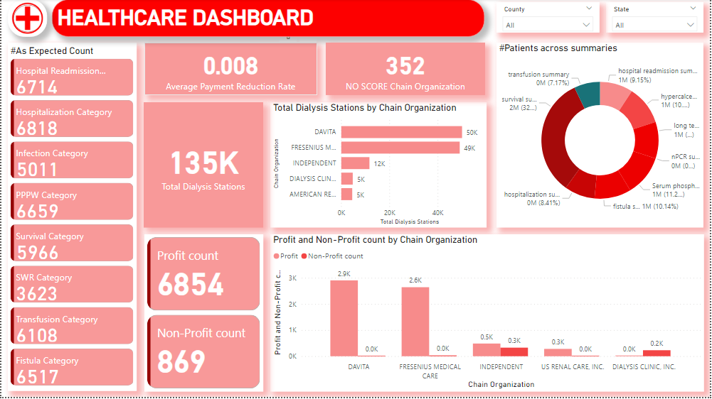
Dashboard
7
Dashboard
7
Dashboard
7

Slide 16
Dashboard
7
Dashboard
7
Conclusion
Target transfusion and hypercalcemia areas with high patient counts.
Analyze the gap between profit and non-profit organizations for strategic insights.
Address missing performance scores for comprehensive tracking.
Share knowledge for efficient dialysis station management.
Strengthen protocols and set benchmarks for consistency.
Manage financial challenges while prioritizing high-quality care.
8

Slide 17
Conclusion
Target transfusion and hypercalcemia areas with high patient counts.
Analyze the gap between profit and non-profit organizations for strategic insights.
Address missing performance scores for comprehensive tracking.
Share knowledge for efficient dialysis station management.
Strengthen protocols and set benchmarks for consistency.
Manage financial challenges while prioritizing high-quality care.
8
Thank You!
9

Slide 18
Conclusion
Target transfusion and hypercalcemia areas with high patient counts.
Analyze the gap between profit and non-profit organizations for strategic insights.
Address missing performance scores for comprehensive tracking.
Share knowledge for efficient dialysis station management.
Strengthen protocols and set benchmarks for consistency.
Manage financial challenges while prioritizing high-quality care.
8
Thank You!
9

